Slide 1
FischerFaces vs EigenFaces
CS 663 Course Project
Niraj Mahajan - 180050069
Samarth Singh - 180050090
Shaan Ul Haque - 180070053

Slide 2
EigenFaces Algorithm
Exploits the fact that most natural face images have a high variance in a lower dimensional subspace.
We use PCA to determine this lower dimensional subspace.
Compute the PCA coefficients of every training image using this PCA.
For a test image compute the coefficients again using the same PCA
Classify the image to a class using the nearest neighbor algorithm
Notes:
Niraj

Slide 3
EigenFaces with varying lighting
Eigenfaces fails on images with a variation in lighting
Variation in lighting dominates the variation in the facial expression, pose and the identity, of a person and hence pollutes the PCA eigenvectors
We can remove the top 3 eigenvectors to get better results.
Notes:
Niraj

Slide 4
Why top 3 eigenvectors?
Images of a person with the same pose and expression form a rank 3 subspace under varied lighting conditions.
I = Lρ(x,y)l^{T}N
Here I = scene radiance, L = lighting Intensity, l = lighting direction,
N = unit surface normal, ρ = surface reflectivity
Notes:
Niraj

Slide 5
Why top 3 eigenvectors? (ctd)
I_{k}(x,y) = Lρ(x,y)N(x,y).l_{k}
(I₁ I₂… I_{m}) = LρN(l₁ l₂... l_{m})
I = ND, I ∊ R^{Mxm}, N ∊ R^{Mx3} has the unit normals at (x,y) times Lρ(x,y) D ∊ R^{3xm}
Using property Rank(A_{mxk}B_{kxn}) ≤ min{Rank(A_{mxk}), Rank(B_{kxn})}.
Notes:
Niraj

Slide 6
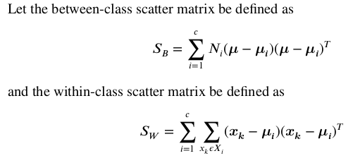
Fischer’s Linear Discriminant
Maximise the interclass mean distance
Minimise the intraclass scatter
Notes:
Niraj

Slide 7
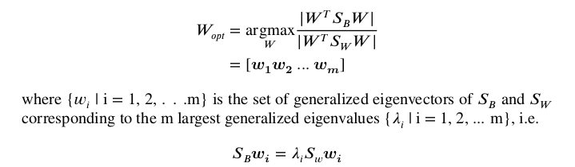
Fischer’s Linear Discriminant (ctd)
If S_{W} is nonsingular, the optimal projection W_{opt} is chosen as the matrix with orthonormal columns which maximizes the ratio of the determinant of the between-class scatter matrix of the projected samples to the determinant of the within-class scatter matrix of the projected samples
Notes:
Niraj

Slide 8
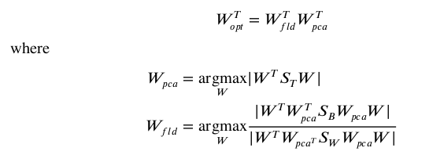
FischerFaces
Note that S_{W} has rank N-c, and hence is always singular.
We first perform PCA to reduce dimensionality to N-c and then perform a Fischer Linear Discriminant on the transformation
Hence W_{opt} is given by
Notes:
Niraj

Slide 9
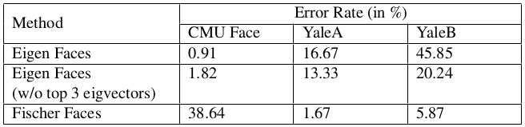
Results - Face Recognition - YaleA
The yale A dataset contains 165 images of 15 individuals.
Each person has images with different facial expressions, configurations and lighting.
Varying lighting -> Fischerfaces outperform eigenfaces
Notes:
Niraj

Slide 10
Results - Face Recognition - YaleB
The Yale Face Database B contains 2415 images of 38 human subjects under varying 64 illumination conditions.
Varying lighting -> Fischerfaces outperform eigenfaces
Notes:
Niraj

Slide 11
Results - Face Recognition - CMU Face
The CMU database consists of images of 20 individuals in different orientations, expressions, but with the same illumination
EigenFaces outperforms FischerFaces!
Notes:
Niraj

Slide 12
Results - Face Recognition - CMU Face (ctd)
Change in Face Alignment - Linear Discriminant Analysis ignores highly changing features of a face. Changing alignment induces excessive variation in face leading the algorithm to neglect whole face.
Non-cropped Images - Even when only frontal images are used results for EigenFaces are better than Fischer Faces because Fischer Face neglects features of an image which vary a lot (such as eyes, mouth, face alignment, etc) and gives a lot of weightage to background due to its non variability and thus loses important information regarding the face.
Notes:
Niraj

Slide 13
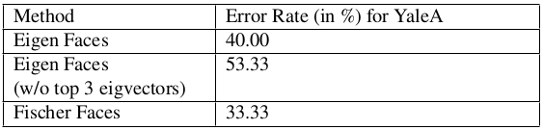
Results - Glasses Recognition - YaleA
The yale A dataset contains images of 15 individuals, each with and without glasses. (No variation in lighting)
Removing the top 3 eigenvectors will lead to loss of vital data, and this too will decrease the accuracy.
Small dataset - leads to high error even for fischerfaces
Notes:
Niraj

Slide 14
Conclusions
We thus conclude that the Fisherface method appears to be the best at extrapolating and interpolating over variation in lighting.
Removing the largest three principal components does improve the performance of the Eigenface method in the presence of lighting variation, but harms the accuracy if lighting variations are not present.
The Fisherface method appears to be the best at simultaneously handling variation in lighting and expression. Also, the fischerface method tries to ignore the features within the same class that have high variances.
Notes:
Niraj

Slide 15
References
P. N. Belhumeur, J. P. Hespanha, and D. J. Kriegman. “Eigenfaces vs. Fisherfaces: recognition using class specific linear projection”. In: IEEE Transactions on Pattern Analysis and Machine Intelligence 19.7 (1997), pp. 711720. DOI : 10.1109/34.598228.
Dheeru Dua and Casey Graff. CMU Face Images Dataset UCI Machine Learning Repository. 2017. URL : http://archive.ics.uci.edu/ml.
Richard O. Duda and Peter E. Hart. Pattern classification and scene analysis / Richard O. Duda, Peter E. Hart. English. Wiley New York, 1973, xvii,482 pages : ISBN : 0471223611. URL : http://www.loc.gov/catdir/enhancements/fy0607/72007008-t.html.
A.S. Georghiades, P.N. Belhumeur, and D.J. Kriegman. “From Few to Many:Illumination Cone Models for Face Recognition under Variable Lighting and Pose”. In: IEEE Trans. Pattern Anal. Mach. Intelligence 23.6 (2001), pp. 643660.
Notes:
Bhaskar

